Slide 1

New Mexico Crime Victims Reparation Commission

Slide 2
Who is CVRC?
The Crime Victims Reparation Commission (CVRC) assists victims of violent crime with expenses incurred as a result of their victimization.
CVRC also administers funding to organizations to provide victim services statewide.

Slide 3
Types of Emergency Funds
Emergency Assistance Funds
New Mexico Coalition of Sexual Assault Programs Emergency Funds
Human Trafficking Crisis Stabilization Funds

Slide 4
NMCSAP Emergency Funds
WHAT: For Survivors of Sexual Violence
WHEN: Mon-Fri, 8 a.m. – 5 p.m.
HOW: Must be initiated by victim advocate
HOW: Advocate must call the New Mexico Coalition of Sexual Assault Programs

Slide 5
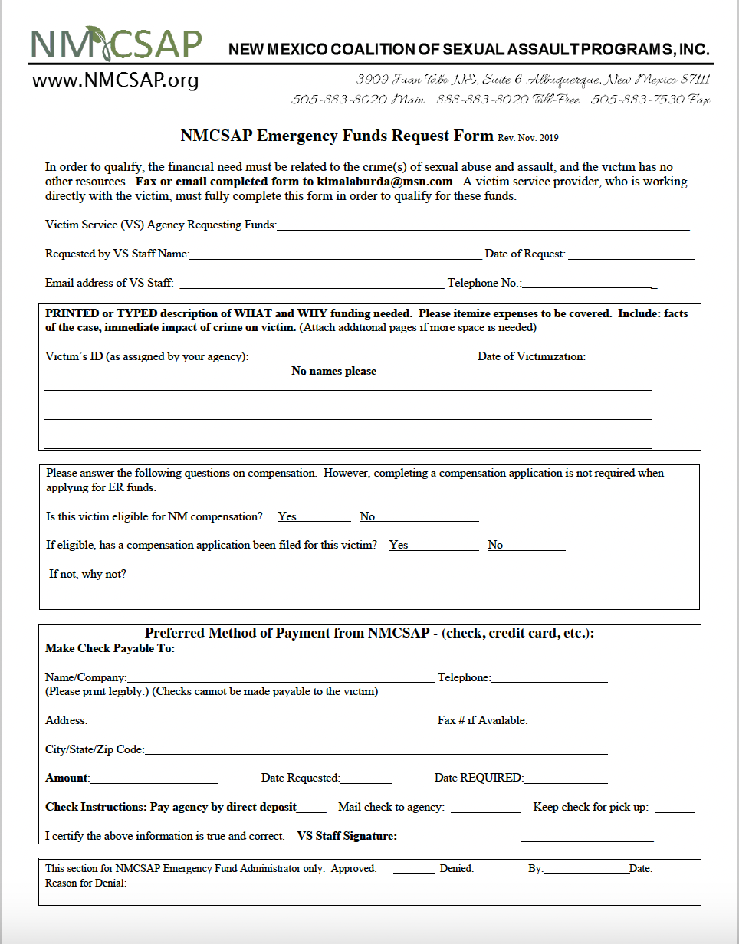
NMCSAP Request Form
Submit NMCSAP Emergency Funds Request Form with supporting documentation to the coalition

Slide 6
Human Trafficking Crisis Stabilization
WHAT: For Survivors of Human Trafficking
WHEN: Mon-Fri, 8 a.m. – 5 p.m.
HOW: Must be initiated by victim advocate
HOW: Advocate must call La Piñon, New Mexico Immigrant Law Center, the Life Link, Rape Crisis Center of Central New Mexico, or CVRC

Slide 7

Human Trafficking Crisis Stabilization
PURPOSE
  To assist victims of Human Trafficking in situations in which their health and/or safety are at risk when resources are needed. The primary purpose is to help decrease the emotional trauma experience by victims of human trafficking
NOTE
  This funding is not intended to be a substitute for victims’ compensation.
  Please complete the compensation application online.

Slide 8
Victims of Human Trafficking
Identified as a victim of human trafficking by:
Law Enforcement
Prosecutors
Mental Health provider
Medical provider

Slide 9
Human Trafficking Guidelines
Maximum $10,000
Once in a lifetime access
Immediate health and safety risk

Slide 10
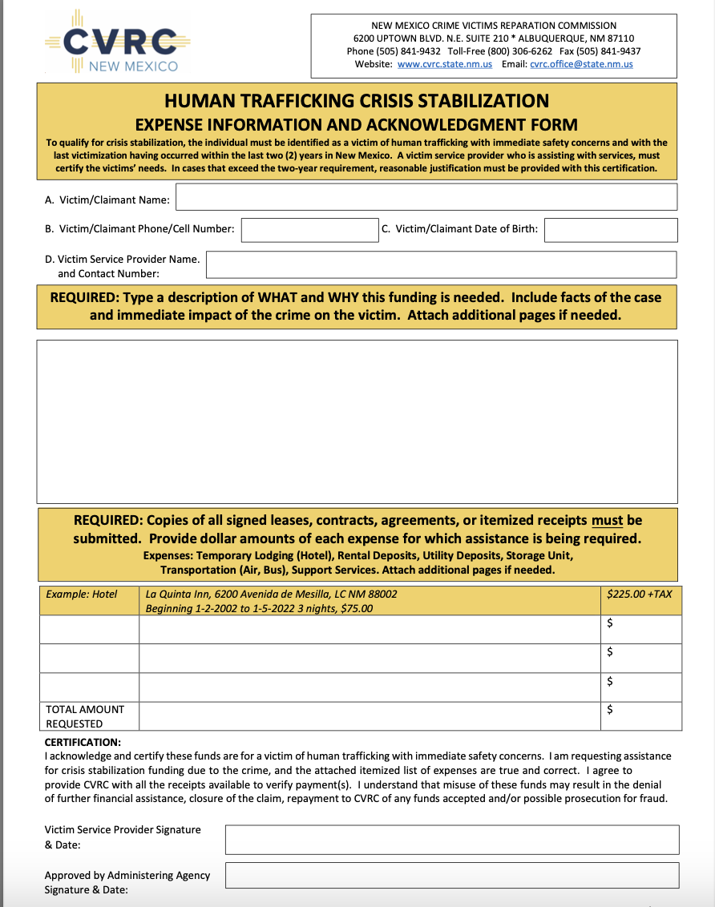
HT Request Form
Submit HT Crisis Stabilization Form with supporting documentation to the administering agency

Slide 11
Emergency Assistance Funds
WHAT: Up to $2,000
WHEN: Mon-Fri, 8 a.m. – 5 p.m.
(Depends on Administering Agency)
HOW: Must be initiated by victim advocate
HOW: Advocate may call regional ER administering agency to discuss eligibility

Slide 12
Emergency Assistance Funds Criteria
Immediate health &/or safety issues - direct result of a victimization and no other resources available
Must attempt contact with one other viable resource
(not required to receive response)
Must complete Emergency Assistance Funds Check Request Form and email/fax to Administering Agency
Allow up to 24 hours to get funding
Once in a lifetime request

Slide 13
Emergency Assistance Funds Administering Agencies
Albuquerque SANE Collaborative
Assurance Home, Inc.
Community Against Violence (CAV)
El Refugio, Inc.
La Pinon Sexual Assault Recovery Services
New Mexico Crime Victims Reparation Commission
Rape Crisis Center of Central New Mexico
Roberta’s Place
S.A.F.E. House
Sexual Assault Services of Northwestern New Mexico

Slide 14
Allowable Emergency Assistance Costs
Utilities/Rent Arrears associated with the victimization
(should be reasonable- must receive CVRC approval)
1 month relocation/rent/ utilities - immediate safety issue (no deposits)
Windows/door/lock repair/replacement
ER counseling/some medical/some prescriptions

Slide 15
Allowable Emergency Assistance Costs
Eyeglasses/contacts/hearing aids Mileage/per diem (transportation)
Crime scene cleanup
Emergency civil legal assistance
  (Attorney must agree to the one-time fee and follow case through completion)
Emergency shelter/temporary housing/hotel
Emergency food and clothing *

Slide 16
Ineligible Costs
All Deposits
Funeral/burial expenses
Prosecution/investigation activities
Medical care
Long term housing
Expenses related to recovering lost property
Non-emergency or need not related to crime

Slide 17
EAF Request Form
Submit Emergency Assistance Funds Request Form with supporting documentation to the administering agency

Slide 18
QUESTIONS?

Slide 19
Locate Documents www.cvrc.state.nm.us

Slide 20
www.cvrc.state.nm.us
505-841-9432
Thank you

